Slide 1
Pause for feedback Please take a few minutes to complete the brief “Pause or feedback” survey.

Slide 2
Big Data
Week 7: Machine Learning I
Q & A

Slide 3
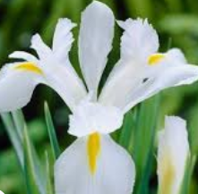
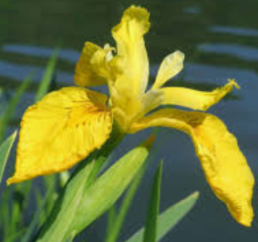
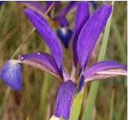
Iris data
sepal length | sepal width | petal length | petal width | Iris Type
5.1 | 3.5 | 1.4 | 0.2 | Iris-setosa
4.9 | 3 | 1.4 | 0.2 | Iris-setosa
4.7 | 3.2 | 1.3 | 0.2 | Iris-setosa
7 | 3.2 | 4.7 | 1.4 | Iris-versicolor
6.4 | 3.2 | 4.5 | 1.5 | Iris-versicolor
6.9 | 3.1 | 4.9 | 1.5 | Iris-versicolor
5.5 | 2.3 | 4 | 1.3 | Iris-versicolor
5.8 | 2.7 | 5.1 | 1.9 | Iris-virginica
7.1 | 3 | 5.9 | 2.1 | Iris-virginica

Slide 4
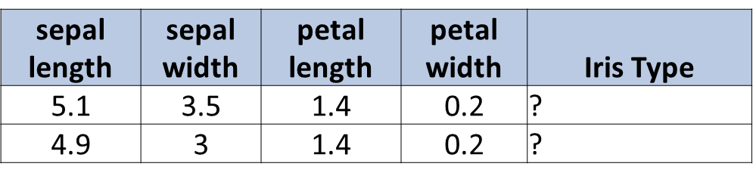

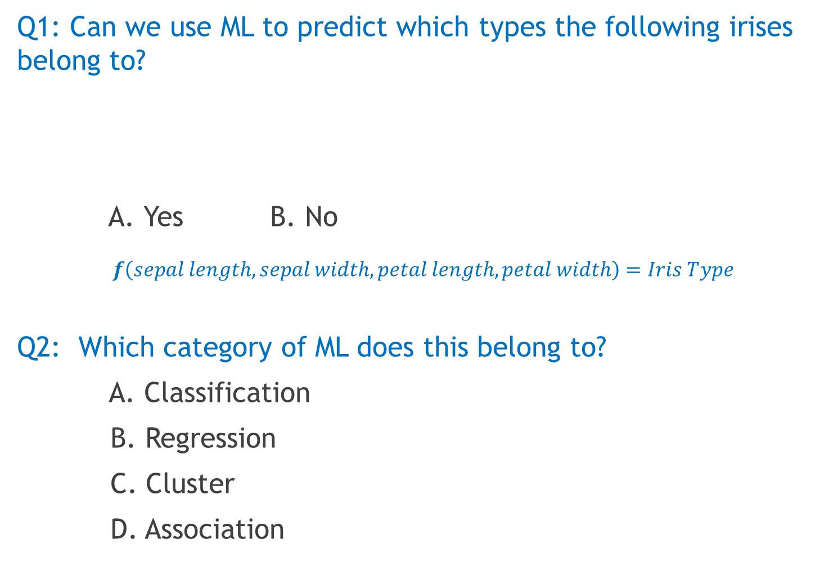
Q1: Can we use ML to predict which types the following irises belong to?
A. Yes B. No
$$f\left(sepal length, sepal width, petal length, petal width\right)=Iris Type$$
Q2: Which category of ML does this belong to?
A. Classification
B. Regression
C. Cluster
D. Association

Slide 5
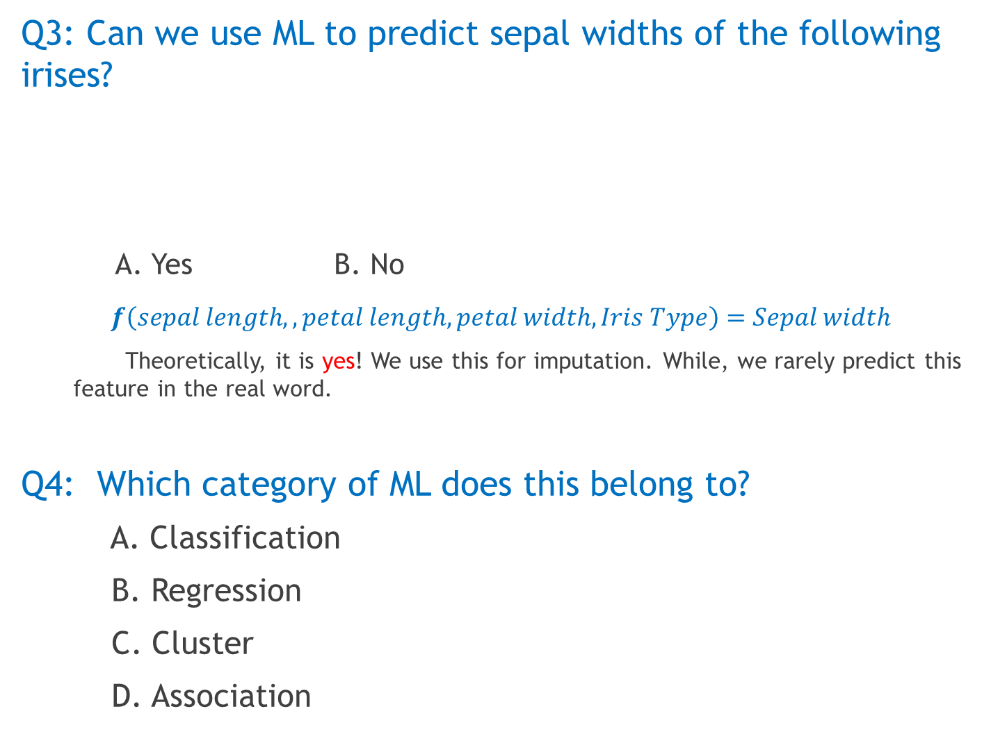
Q3: Can we use ML to predict sepal widths of the following irises?
A. Yes B. No
$$f\left(sepal length,, petal length, petal width,Iris Type\right)=Sepal width$$
Theoretically, it is yes! We use this for imputation. While, we rarely predict this feature in the real word.
Q4: Which category of ML does this belong to?
A. Classification
B. Regression
C. Cluster
D. Association
sepal length | sepal width | petal length | petal width | Iris Type
5.4 | ? | 1.3 | 0.4 | Iris-setosa
6.1 | ? | 4.7 | 1.2 | Iris-versicolor

